Slide 1
Triggers
C393: Database Systems

Slide 2
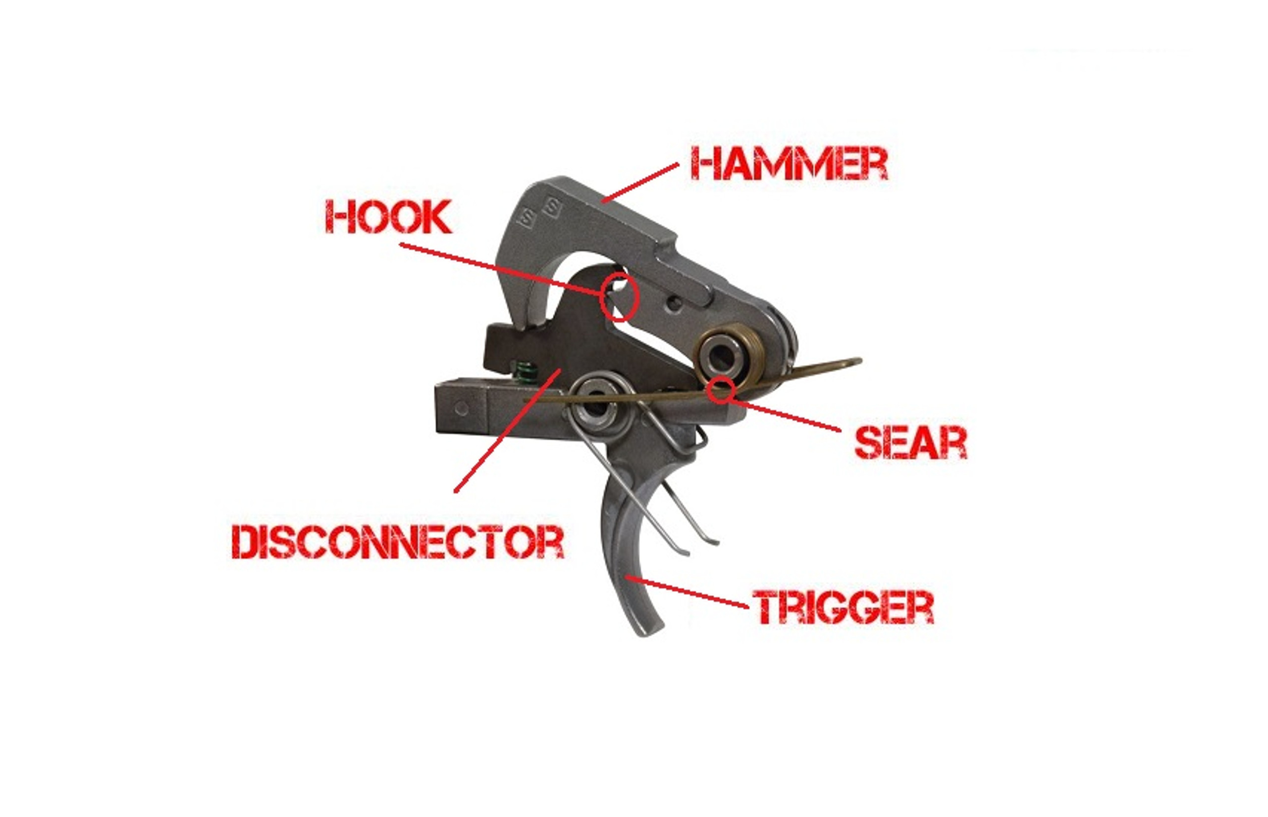
Triggers
Notes:
Jk, that’s not this lesson…
I wouldn’t want you to fire too many questions haha

Slide 3
Review

Slide 4
Lesson Objectives
Apply SQL triggers to respond to database events

Slide 5
Triggers
Apply a series of steps before or after an insert, update, or delete statement.
CREATE TRIGGER [IF NOT EXISTS] trigger_name
trigger_time trigger_event ON tbl_name
FOR EACH ROW [trigger_order]
trigger_body
trigger_time: { BEFORE | AFTER }
trigger_event: { INSERT | UPDATE | DELETE }
trigger_order: { FOLLOWS | PRECEDES } other_trigger_name

Slide 6
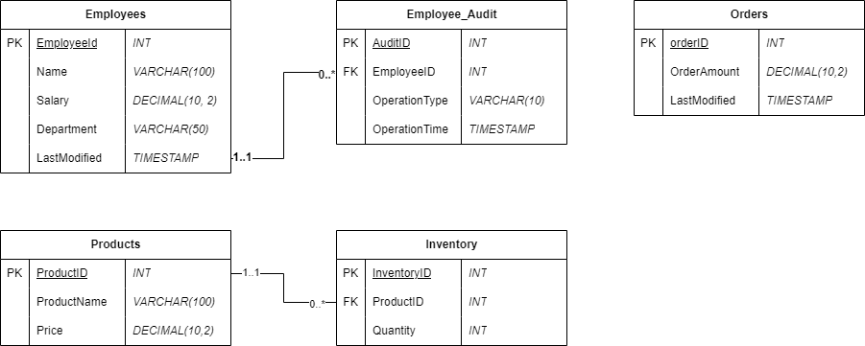
Design Diagram

Slide 7
AFTER / UPDATE
DELIMITER $$
CREATE TRIGGER Employee_Audit_Log
AFTER UPDATE ON Employees
FOR EACH ROW
BEGIN
INSERT INTO Employee_Audit (EmployeeID, OperationType)
VALUES (OLD.EmployeeID, 'UPDATE’);
END $$
DELIMITER ;

Slide 8
BEFORE / INSERT
DELIMITER $$
CREATE TRIGGER Validate_Salary
BEFORE INSERT ON Employees
FOR EACH ROW
BEGIN
IF NEW.Salary < 0 THEN
SIGNAL SQLSTATE '45000'
SET MESSAGE_TEXT = 'Salary cannot be negative.';
END IF;
END $$
DELIMITER ;

Slide 9
BEFORE / DELETE
Look at the entries in the Products and Inventory tables.
Delete the ‘Laptop’ product. What happens?
Create a trigger that deletes the related inventory records before a product is deleted.
Delete the ‘Mouse’ product. What happens to the Inventory table?
How many rows were affected by the statement? How many rows were actually affected?

Slide 10
Triggers
Very useful feature
Reduces repetitive tasks
Enforces consistent behavior
“Event-based” automation
Need to be used cautiously
Have “hidden” side effects
May be difficult to debug
Can impact performance (conducts multiple statements for every updated record)

Slide 11
Trigger Order
Unless otherwise specified, triggers execute in the order that they are created
What order do these execute in?
CREATE TRIGGER x AFTER DELETE ON Employees
FOR EACH ROW
…
END;
CREATE TRIGGER y AFTER DELETE ON Employees
FOR EACH ROW PRECEDES x
…
END;
CREATE TRIGGER z AFTER DELETE ON Employees
FOR EACH ROW FOLLOWS y
…
END;

Slide 12
Inspecting Triggers
SHOW TRIGGERS;
SELECT * FROM INFORMATION_SCHEMA.TRIGGERS WHERE EVENT_OBJECT_SCHEMA = 'database_name';

Slide 13
Your Turn
Import the LMS database
Review the LMS design diagram
Create the triggers in the SQL notebook

